Slide 1
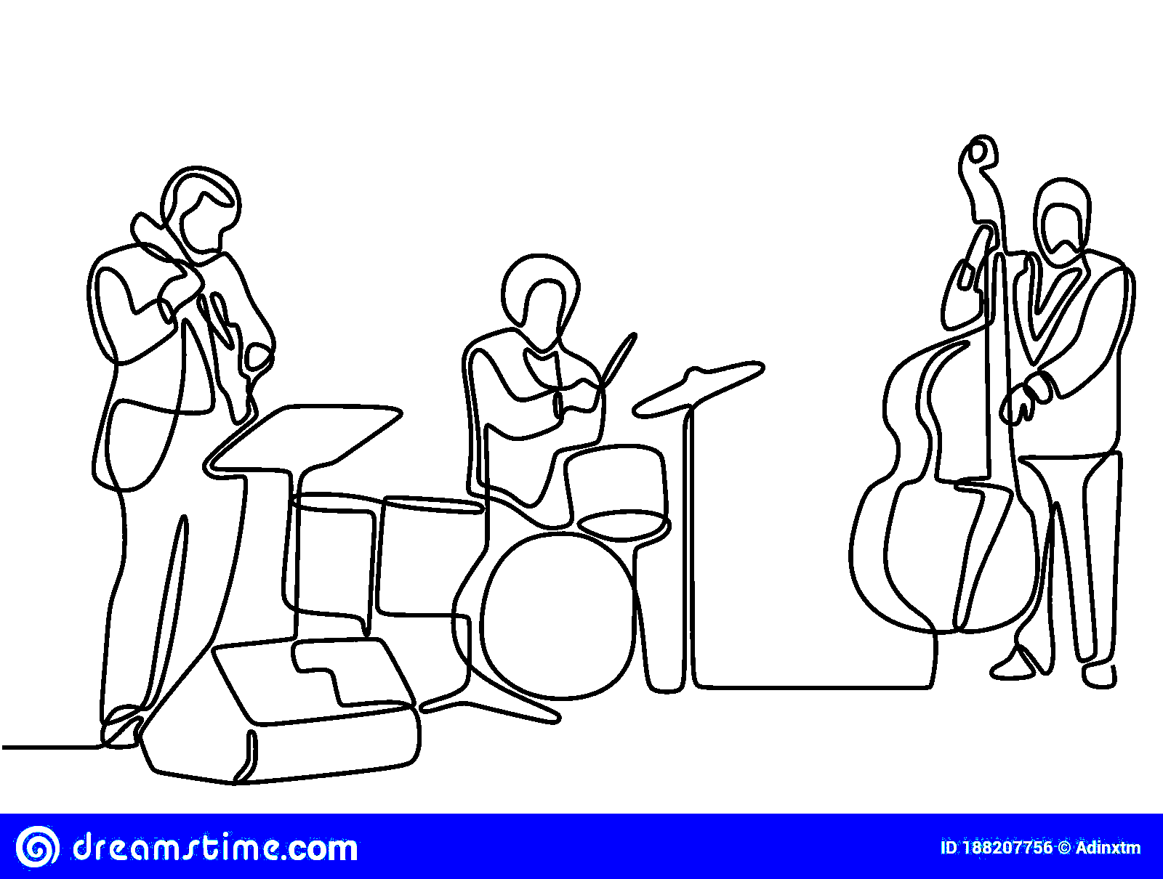
Modern Jazz Discovery Tool

Slide 2
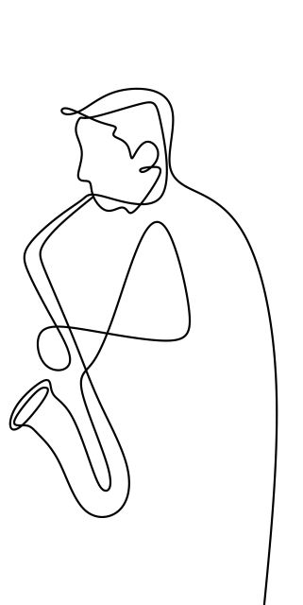
Motivations

Slide 3
Motivations
“Jazz music is the power of now. There is no script. It’s conversation” (Wynton Marsalis – jazz trumpeter)

Slide 4
Motivations
“Jazz music is the power of now. There is no script. It’s conversation” (Wynton Marsalis – jazz trumpeter)
“…only music that has a social epoch named in it’s honor: the Jazz Age (1920’s)” (Gerald Lyn Early – writer for Daedalus)

Slide 5
Motivations
“Jazz music is the power of now. There is no script. It’s conversation” (Wynton Marsalis – jazz trumpeter)
“…only music that has a social epoch named in it’s honor: the Jazz Age (1920’s)” (Gerald Lyn Early – writer for Daedalus)
“Jazz is a child of the 20th century, but it has now left home” (Mike Nock – jazz pianist)

Slide 6
Motivations
“Jazz music is the power of now. There is no script. It’s conversation” (Wynton Marsalis – jazz trumpeter)
“…only music that has a social epoch named in it’s honor: the Jazz Age (1920’s)” (Gerald Lyn Early – writer for Daedalus)
“Jazz is a child of the 20th century, but it has now left home” (Mike Nock – jazz pianist)
“…artists like Kamasi Washington…Kendrick Lamar…forge a new synthesis of jazz…provide a radically new relationship between art and the popular…” (Gerald Lyn Early)

Slide 7
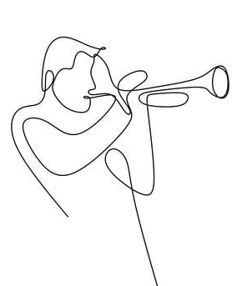
Purpose
Give audiences a tool to discover Modern Jazz Music

Slide 8
Purpose
Give audiences a tool to discover Modern Jazz Music
Allowing users to explore connections to music they already know and love

Slide 9
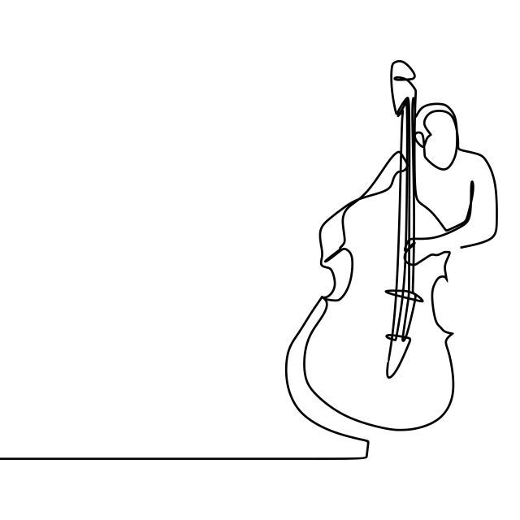
Agenda
Data Insights
Data
Modern Jazz Discovery App
Tool Features
Recommender

Slide 10
Agenda
Data Insights
Data
Modern Jazz Discovery App
Tool Features
Recommender

Slide 11
Agenda
Data Insights
Data
Modern Jazz Discovery App
Tool Features
Recommender

Slide 12
Agenda
Data Insights
Data
Modern Jazz Discovery App
Tool Features
Recommender

Slide 13
Agenda
Data Insights
Data
Modern Jazz Discovery App
Tool Features
Recommender

Slide 14
Agenda
Data Insights
Data
Modern Jazz Discovery App
Tool Features
Recommender

Slide 15
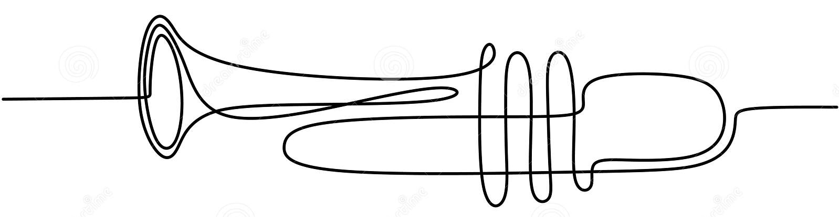
Data

Slide 16
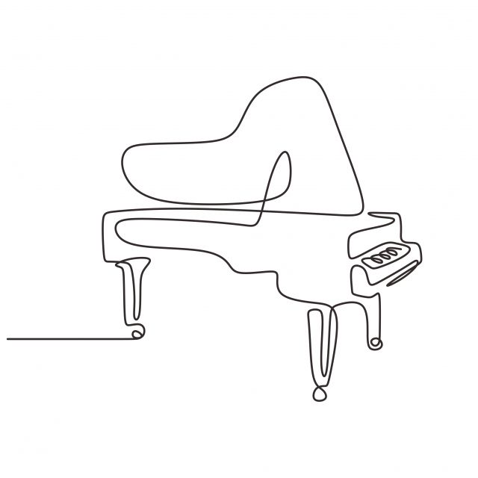





Data
Pitchfork Reviews 1999-2021
~20,000 Pitchfork reviews (~700 Jazz Reviews)
Scraped using Beautiful Soup and Selenium
Tools

Slide 17
1. Data Insights

Slide 18

Sub-Genre Classifying (Phrase Matching)
PITCHFORK JAZZ ALBUM REVIEW
“….an artist best known for soulful, worldly down tempo tries his hand at upbeat house…his melodies and live instrumentation hint at a fondness for jazz, soul, folk, and minimalism…” (Pitchfork Review of Bonobo)

Slide 19
Sub-Genre Classifying (Phrase Matching)
PITCHFORK JAZZ ALBUM REVIEW
“….an artist best known for soulful, worldly down tempo tries his hand at upbeat house…his melodies and live instrumentation hint at a fondness for jazz, soul, folk, and minimalism…” (Pitchfork Review of Bonobo)

Slide 20

Sub-Genre Classifying (Phrase Matching)
GENRE
Electronic
Jazz
Blues/Soul
Folk/Country
SUB-GENRE
Down tempo
House
Jazz
Soul
Folk
Minimalism
MusicBrainz

Slide 21
Sub-Genre Classifying (Phrase Matching)
GENRE
Electronic
Jazz
Blues/Soul
Folk/Country
SUB-GENRE
Down tempo
House
Jazz
Soul
Folk
Minimalism
MusicBrainz

Slide 22
Sub-Genre Classifying (Phrase Matching)
GENRE
Electronic
Jazz
Blues/Soul
Folk/Country
SUB-GENRE
Down tempo
House
Jazz
Soul
Folk
Minimalism
PITCHFORK REVIEW
“….an artist best known for soulful, worldly down tempo tries his hand at upbeat house…his melodies and live instrumentation hint at a fondness for jazz, soul, folk, and minimalism…” (Pitchfork Review of Bonobo)
MusicBrainz
MusicBrainz

Slide 23
Sub-Genre Classifying (Phrase Matching)
GENRE
Electronic
Jazz
Blues/Soul
Folk/Country
SUB-GENRE
Down tempo
House
Minimalism
Jazz
Soul
Folk
PITCHFORK REVIEW
“….an artist best known for soulful, worldly down tempo tries his hand at upbeat house…his melodies and live instrumentation hint at a fondness for jazz, soul, folk, and minimalism…” (Pitchfork Review of Bonobo)
MusicBrainz
MusicBrainz

Slide 24
Sub-Genre Classifying (Phrase Matching)
GENRE
Electronic
Jazz
Blues/Soul
Folk/Country
SUB-GENRE
Down tempo
House
Minimalism
Jazz
Soul
Folk
PITCHFORK REVIEW
“….an artist best known for soulful, worldly down tempo tries his hand at upbeat house…his melodies and live instrumentation hint at a fondness for jazz, soul, folk, and minimalism…” (Pitchfork Review of Bonobo)
MusicBrainz
MusicBrainz

Slide 25
Sub-Genre Classifying (Phrase Matching)
GENRE
Electronic
Jazz
Blues/Soul
Folk/Country
SUB-GENRE
Down tempo
House
Minimalism
Jazz
Soul
Folk
PITCHFORK REVIEW
“….an artist best known for soulful, worldly down tempo tries his hand at upbeat house…his melodies and live instrumentation hint at a fondness for jazz, soul, folk, and minimalism…” (Pitchfork Review of Bonobo)
MusicBrainz
MusicBrainz

Slide 26
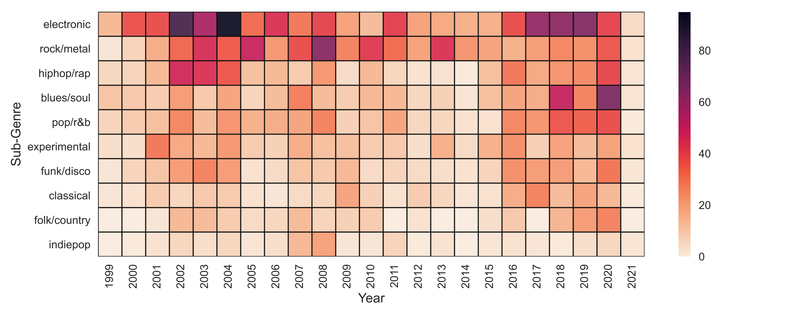
Sub-Genre Mentions Over Time

Slide 27
Sub-Genre Mentions Over Time
St Germain, Thievery Corporation
Radiohead, Wilco
Kendrick Lamar, Tyler the Creator
Top 3

Slide 28
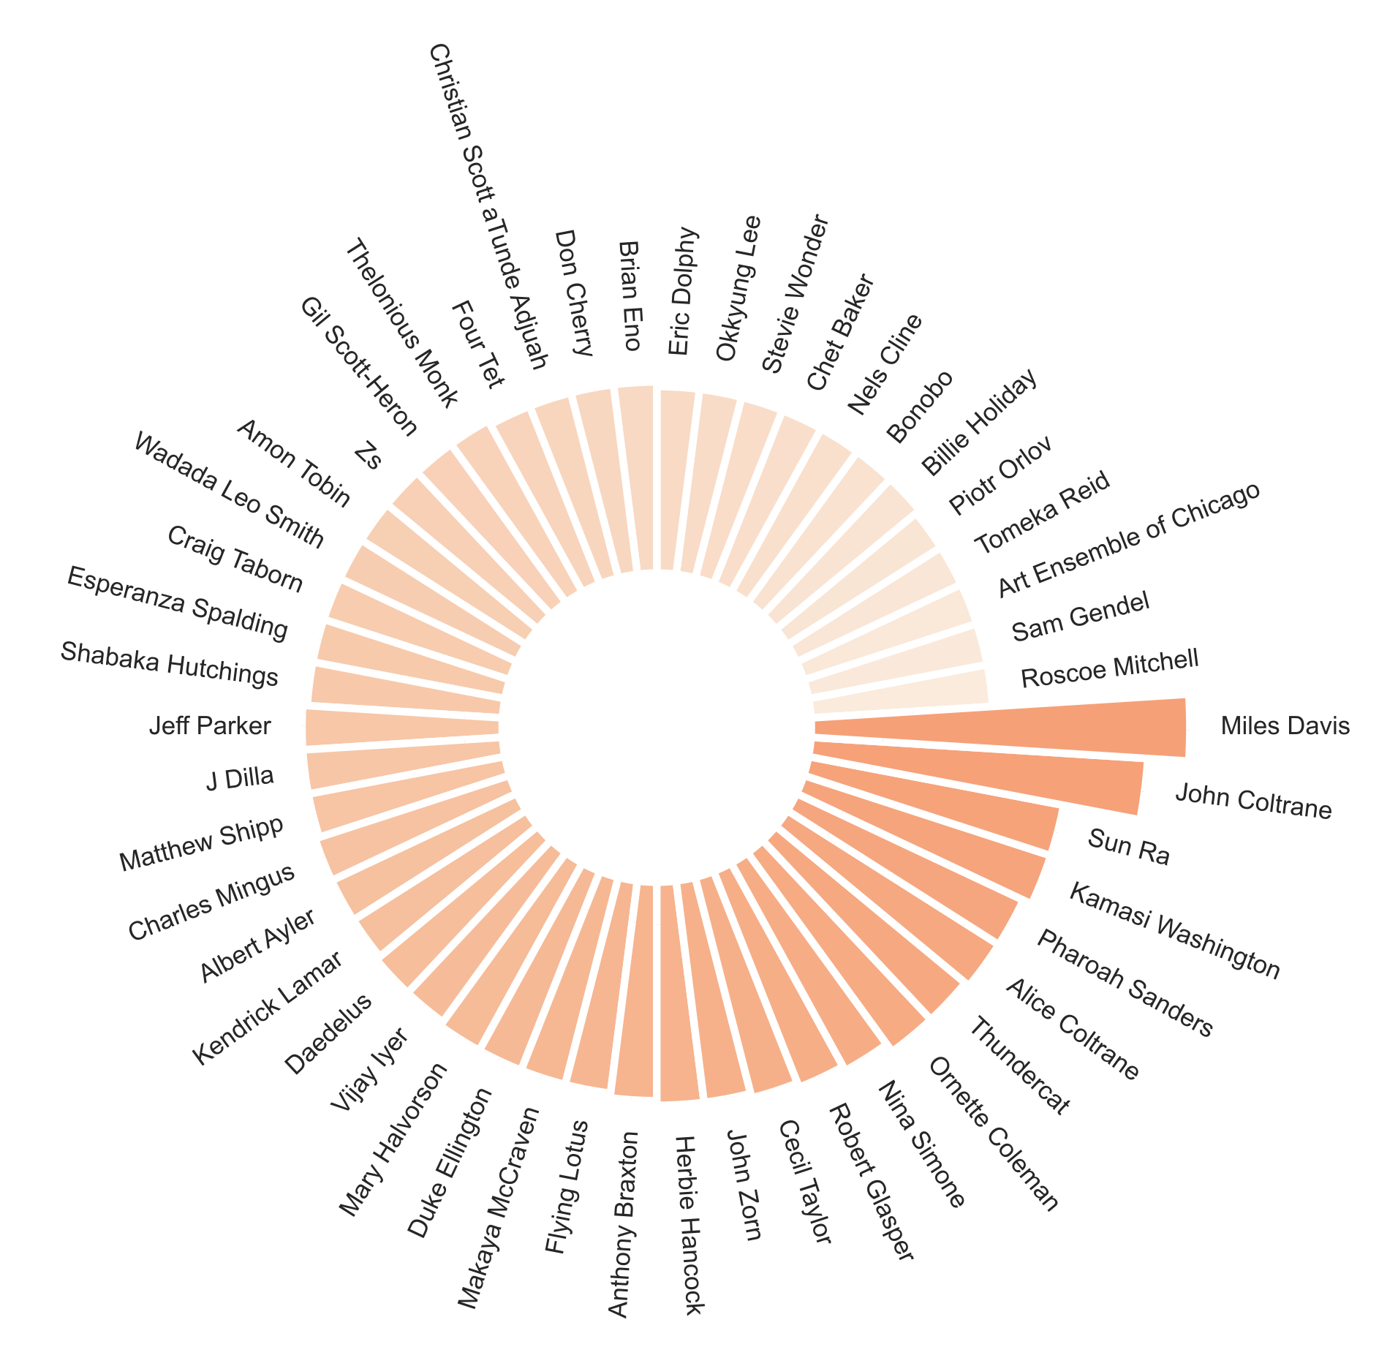
Top 50 Artists most frequently mentioned in reviews

Slide 29
Top 50 Artists most frequently mentioned in reviews

Slide 30
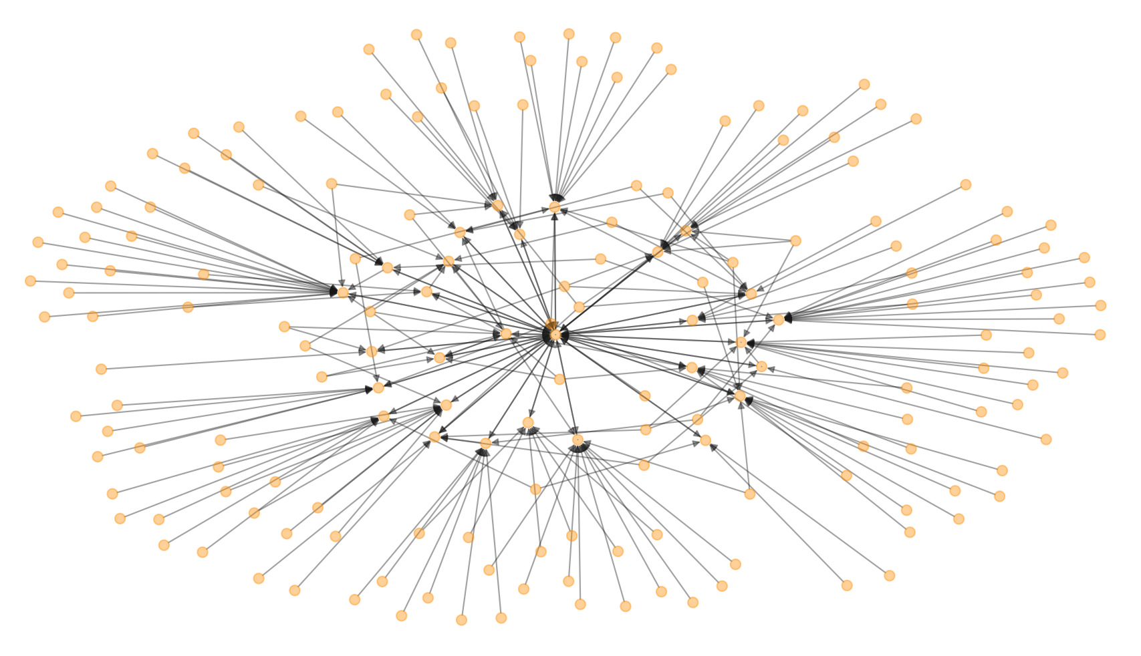
Modern Jazz Influencers (New and Old)
Peter Gabriel
Joey DeFrancesco
Beastie Boys
Miles Davis
Steely Dan
Funkadelic
Pete Rock
Robert Glasper
Kaytranada
9th Wonder
Questlove
Black Milk / Nat Turner
Sonic Youth
Wilco
Danger Mouse

Slide 31
2. Tool Features

Slide 32
NMF Topic Modeling: Instruments
1: piano, piece, composition, quartet, trumpet, solo, melody
2. beat, hiphop, track, sample, dj, drum, mix, rap, bass, production
3. guitar, rock, sound, noise, guitarist, solo, melody, drum
4. horns, voice, singer, life, love, soul, people, day, world
5. experimental, metal, death, riff, fusion, saxophone, eye, drum
6. classic, studio, record, session, performance, version, concert, tune
7. fusion, group, member, guitarist, saxophonist, cover
8. cinematic, film, soundtrack, score, world, cut, earth, percussion

Slide 33
NMF Topic Modeling: Instruments
1: piano, piece, composition, quartet, trumpet, solo, melody
2. beat, hiphop, track, sample, dj, drum, mix, rap, bass, production
3. guitar, rock, sound, noise, guitarist, solo, melody, drum
4. horns, voice, singer, life, love, soul, people, day, world
5. experimental, metal, death, riff, fusion, saxophone, eye, drum
6. classic, studio, record, session, performance, version, concert, tune
7. fusion, group, member, guitarist, saxophonist, cover
8. cinematic, film, soundtrack, score, world, cut, earth, percussion

Slide 34
NMF Topic Modeling: Instruments
1: piano, piece, composition, quartet, trumpet, solo, melody
2. beat, hiphop, track, sample, dj, drum, mix, rap, bass, production
3. guitar, rock, sound, noise, guitarist, solo, melody, drum
4. horns, voice, singer, life, love, soul, people, day, world
5. experimental, metal, death, riff, fusion, saxophone, eye, drum
6. classic, studio, record, session, performance, version, concert, tune
7. fusion, group, member, guitarist, saxophonist, cover
8. cinematic, film, soundtrack, score, world, cut, earth, percussion

Slide 35
NMF Topic Modeling: Instruments
1: piano, piece, composition, quartet, trumpet, solo, melody
2. beat, hiphop, track, sample, dj, drum, mix, rap, bass, production
3. guitar, rock, sound, noise, guitarist, solo, melody, drum
4. horns, voice, singer, life, love, soul, people, day, world
5. experimental, metal, death, riff, fusion, saxophone, eye, drum
6. classic, studio, record, session, performance, version, concert, tune
7. fusion, group, member, guitarist, saxophonist, cover
8. cinematic, film, soundtrack, score, world, cut, earth, percussion

Slide 36
3. Recommendation System

Slide 37
Recommendation System (Content-Based)
TF-IDF Vectorizer (Reviews)

Slide 38
Recommendation System (Content-Based)
TF-IDF Vectorizer (Reviews)
Cosine Similarity

Slide 39
Recommendation System (Content-Based)
TF-IDF Vectorizer (Reviews)
Cosine Similarity
Cosine Similarity | Album | Artist
1.000 | Day Breaks | Norah Jones
0.168 | Swiss Radio Days Vol. 41 – Zurich 1961 | Ray Charles
0.132 | Artscience | Robert Glasper Experiment
0.108 | Harmony of Difference EP | Kamasi Washington

Slide 40
Recommendation System (Content-Based)
TF-IDF Vectorizer (Reviews)
Cosine Similarity
Cosine Similarity | Album | Artist
1.000 | Day Breaks | Norah Jones
0.168 | Swiss Radio Days Vol. 41 – Zurich 1961 | Ray Charles
0.132 | Artscience | Robert Glasper Experiment
0.108 | Harmony of Difference EP | Kamasi Washington

Slide 41
Recommendation System (Content-Based)
TF-IDF Vectorizer (Reviews)
Cosine Similarity
Cosine Similarity | Album | Artist
1.000 | Day Breaks | Norah Jones
0.168 | Swiss Radio Days Vol. 41 – Zurich 1961 | Ray Charles
0.132 | Artscience | Robert Glasper Experiment
0.108 | Harmony of Difference EP | Kamasi Washington
“Country music”
“Honky-Tonk”

Slide 42
Recommendation System (Content-Based)
TF-IDF Vectorizer (Reviews)
Cosine Similarity
Cosine Similarity | Album | Artist
1.000 | Day Breaks | Norah Jones
0.168 | Swiss Radio Days Vol. 41 – Zurich 1961 | Ray Charles
0.132 | Artscience | Robert Glasper Experiment
0.108 | Harmony of Difference EP | Kamasi Washington
“Country music”
“Honky-Tonk”
“Career”

Slide 43
Recommendation System (Content-Based)
TF-IDF Vectorizer (Reviews)
Cosine Similarity
Cosine Similarity | Album | Artist
1.000 | Day Breaks | Norah Jones
0.168 | Swiss Radio Days Vol. 41 – Zurich 1961 | Ray Charles
0.132 | Artscience | Robert Glasper Experiment
0.108 | Harmony of Difference EP | Kamasi Washington
“Country music”
“Honky-Tonk”
“Career”
“Singer”
“Voice”

Slide 44
Future Improvements
Link to Spotify Audio for streaming albums
Obtain more reviews through other sites (i.e. stereogum, jazztimes, paste, bandcamp, etc.)
Use non-jazz reviews for more interesting insights and connections for search capabilities
Incorporate collaborative filtering using ”like” button
Use Spotify Audio Features as part of the recommendation algorithm

Slide 45
Thank You

Slide 46
Appendix

Slide 47
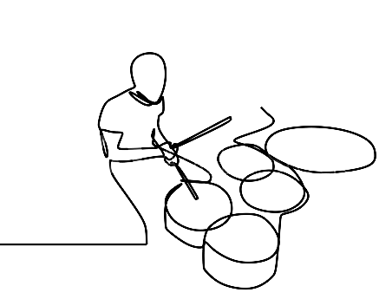
References
1. Pitchfork Reviews: https://pitchfork.com/
2. Musicbrainz genre classifier: https://musicbrainz.org/
3. NRC Word-Emotion Association Lexicon: https://saifmohammad.com/WebPages/NRC-Emotion-Lexicon.htm

Slide 48
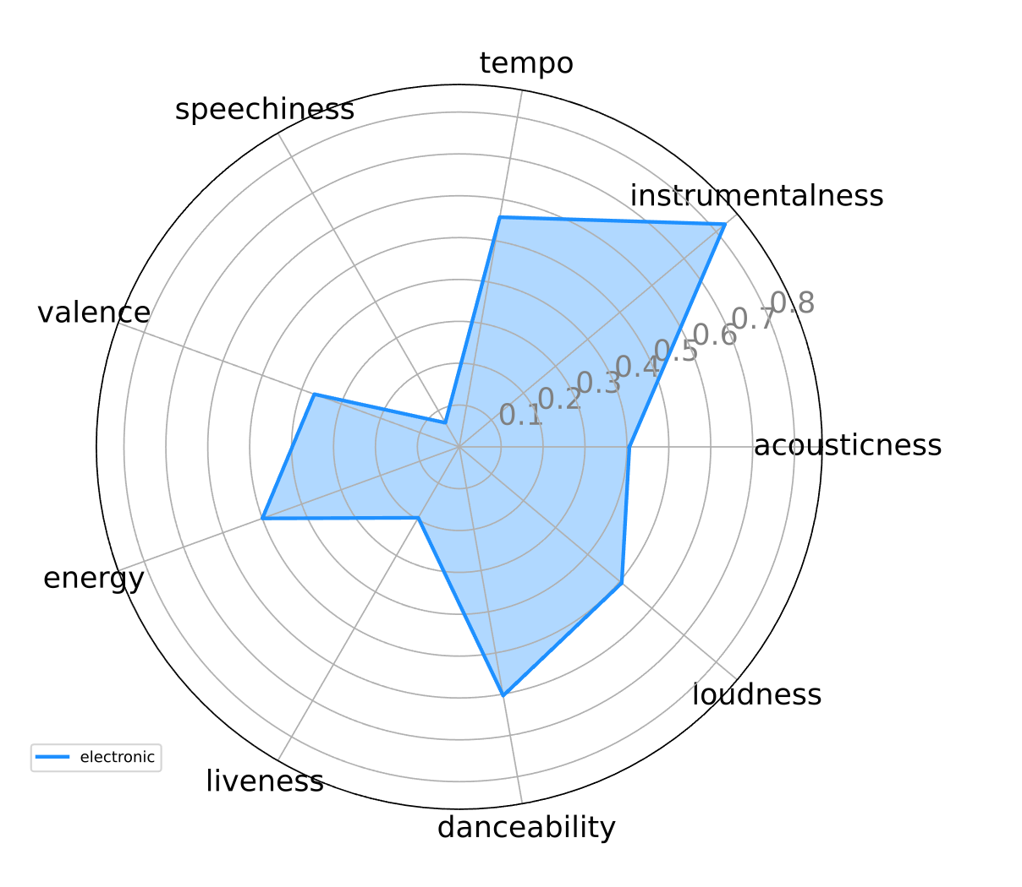
Spotify Audio Features
Electronic: Bonobo (Animal Magic)

Slide 49
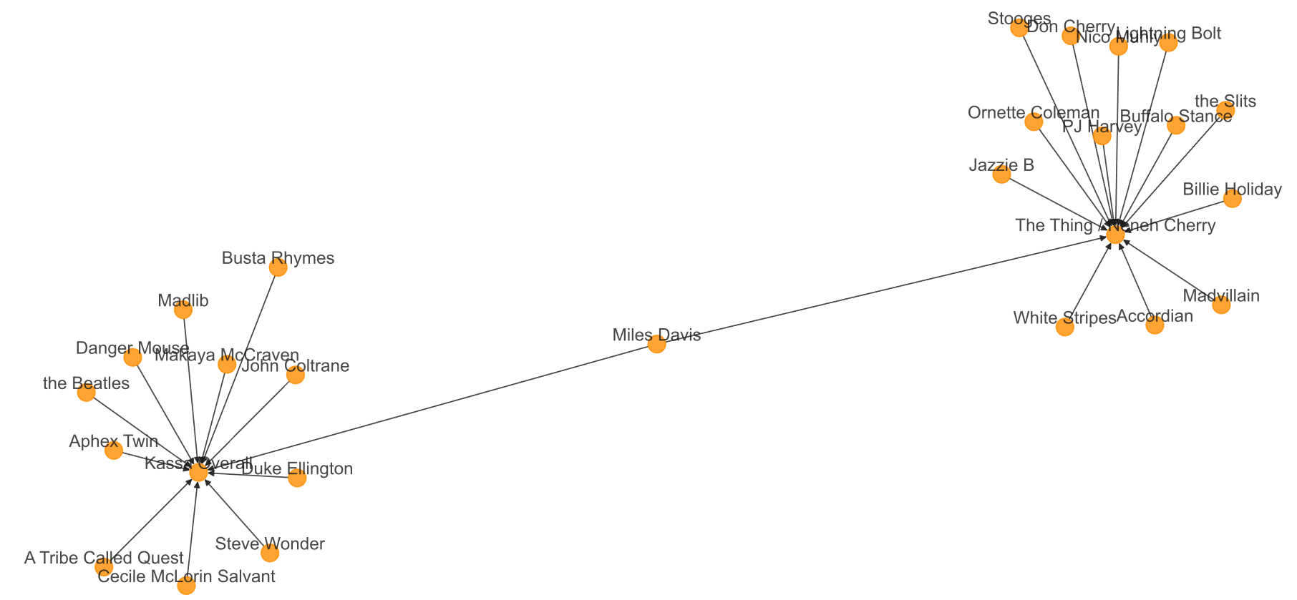
Modern Jazz Influencers (New and Old)

Slide 50
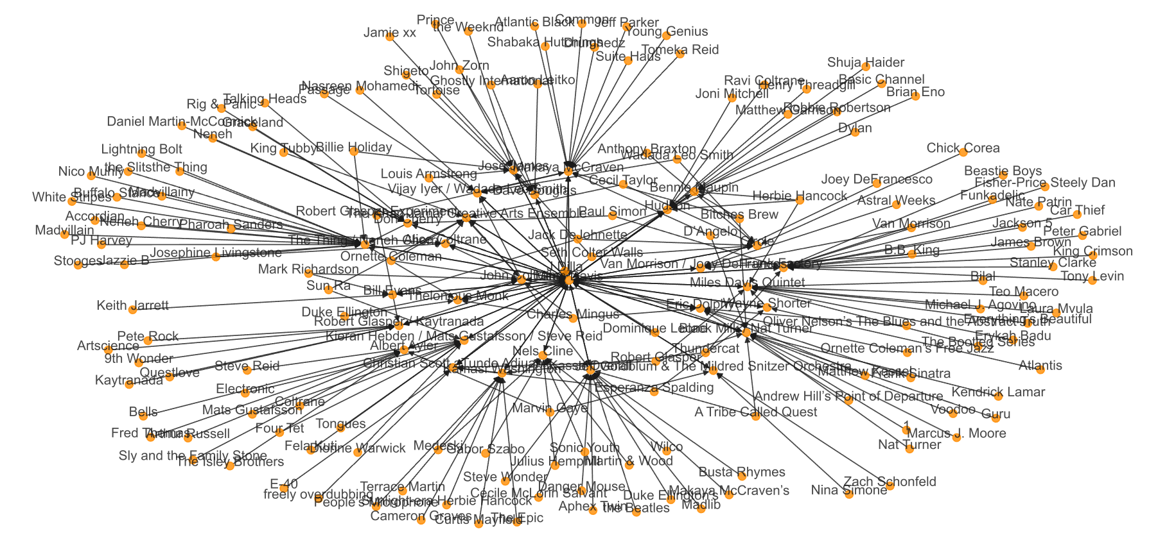
Jazz Influencers (with labels)

Slide 51
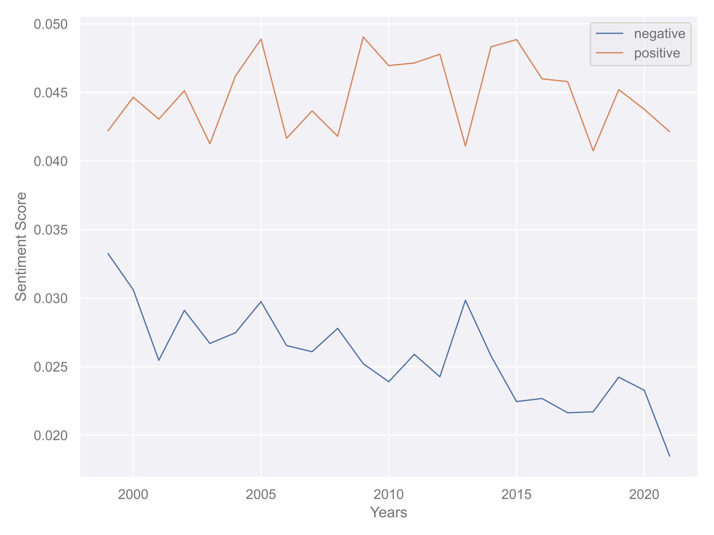
Sentiment Analysis: Pitchfork Jazz Reviews
Positive Sentiment
– no change
Negative Sentiment
– decreasing

